Slide 1
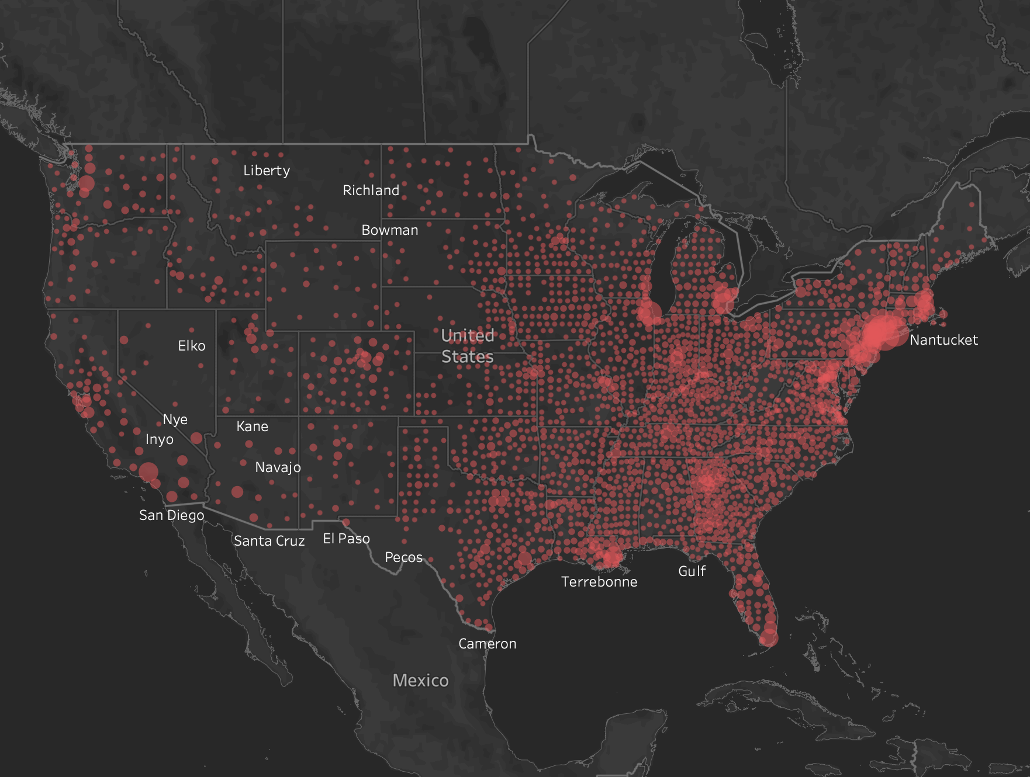

COVID - 19 Challenge
Team: Love Hot Pot​
Notes:
Hi everyone, we are from team Love Hot Pot and we are very excited to be here sharing our analysis and findings about COVID – 19.

Slide 2
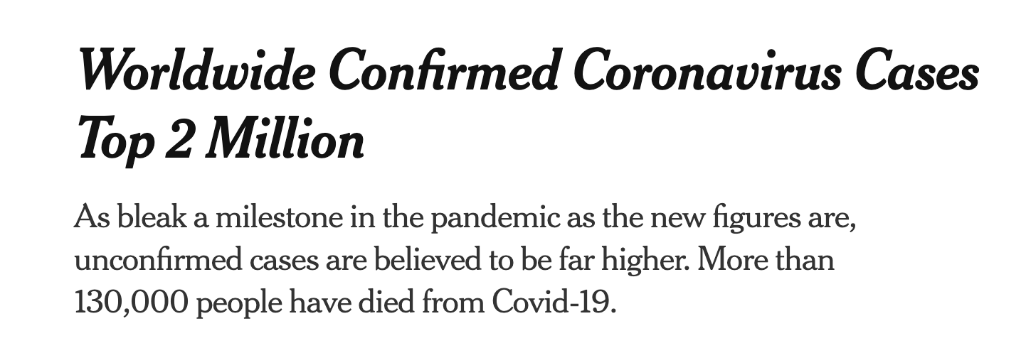
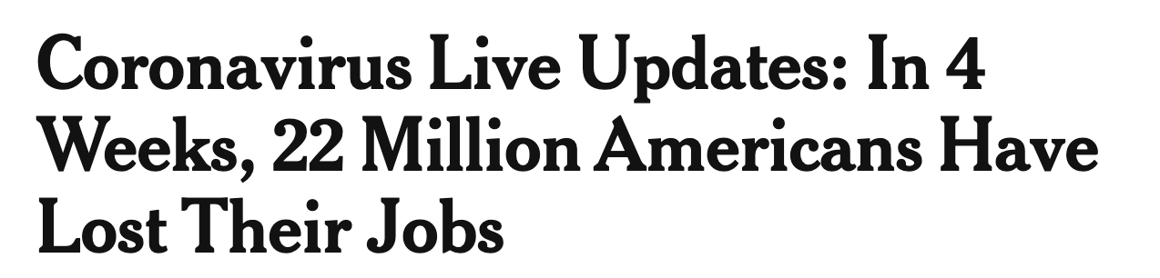
Current situation of COVID-19
Confirmed
Death
Global:
2,115,624
141,195
US:
644,746
28,593
Notes:
Until now, there has been more than 2 million confirmed cases throughout the world and more than 130,000 people have died.
US has almost one-third of the total confirmed cases. As a result, about 22 million Americans have lost their jobs.
This is the current situation about COVID-19. We want to make some contribution to the society based on our analysis. And hopefully our suggestions can help to relieve the situation.

Slide 3
Project Background
Notes:
First, let’s take a look at our project background.

Slide 4
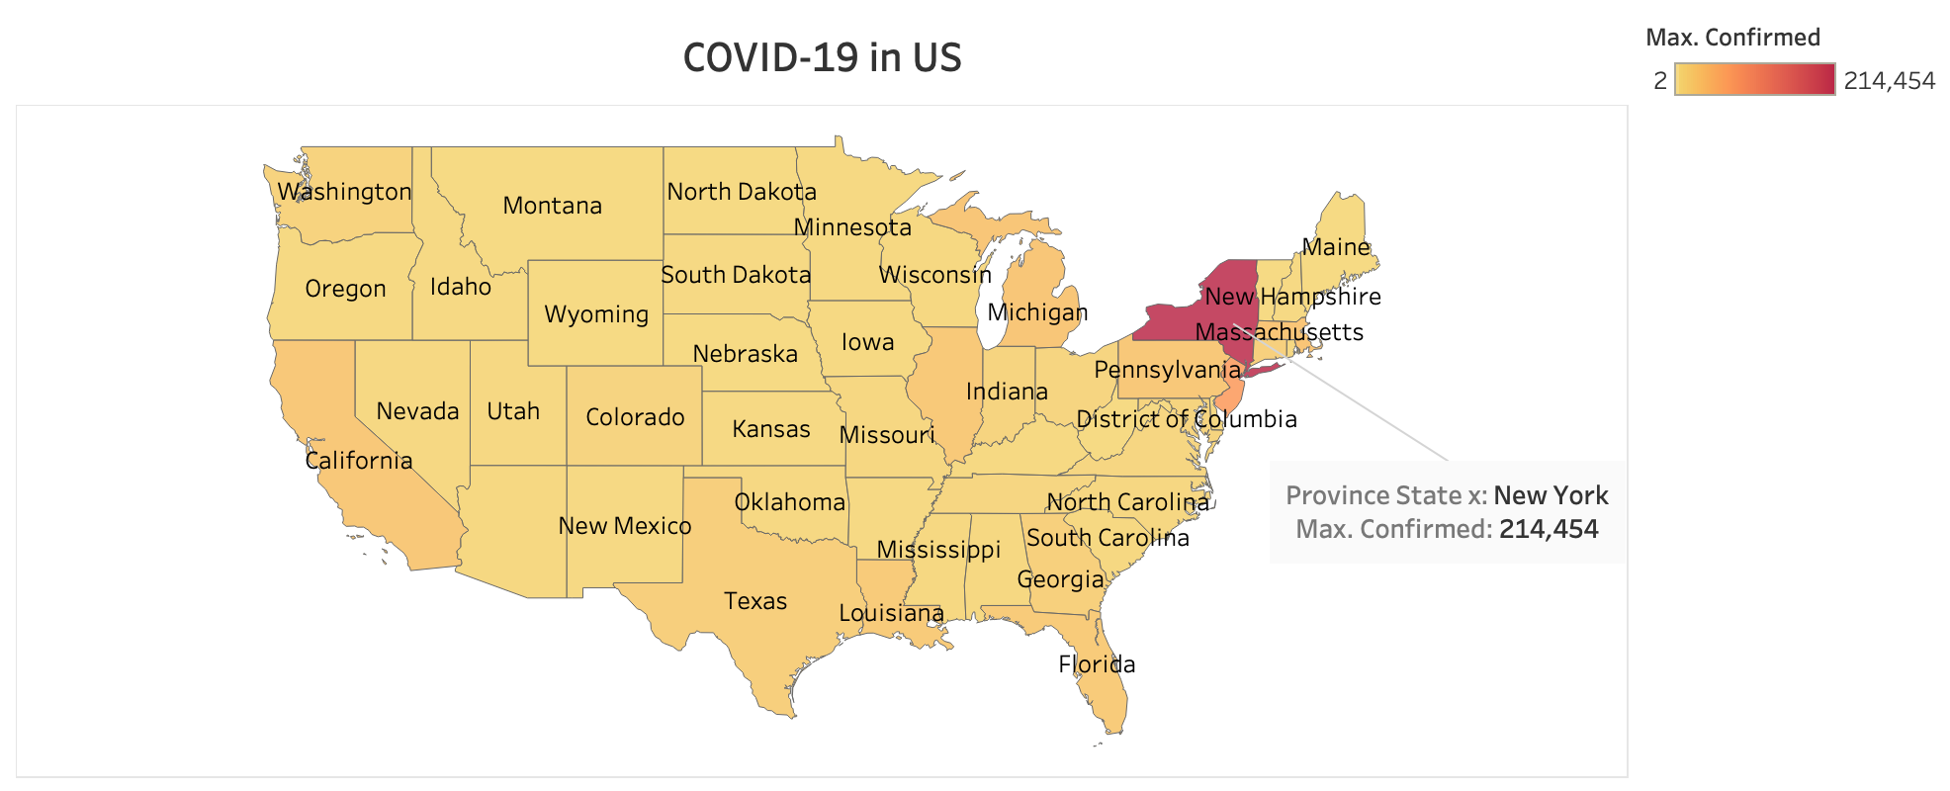
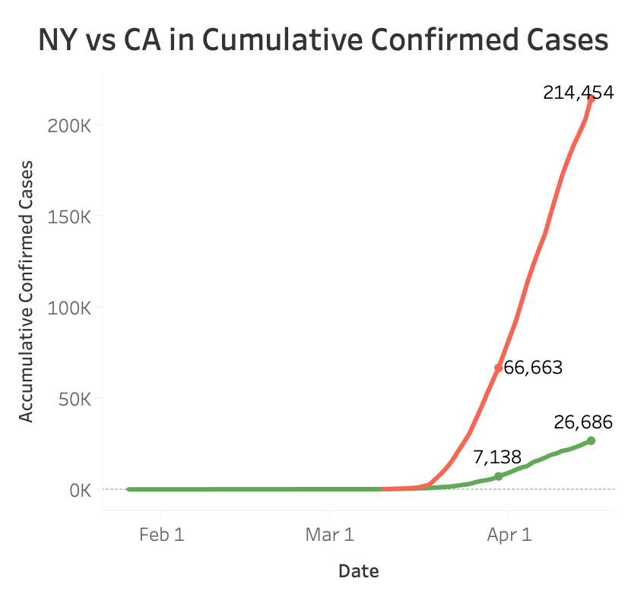
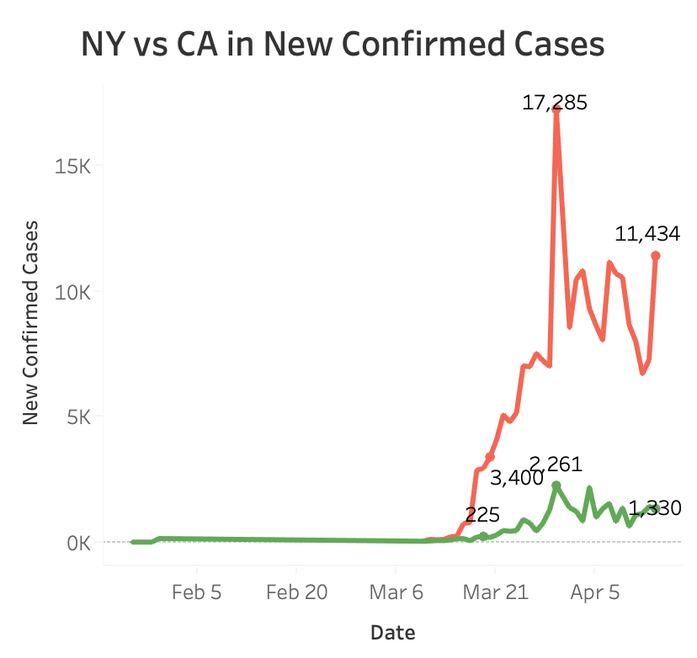
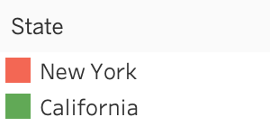
Current situation of COVID-19 in US
Confirmed
Death
Global:
2,115,624
141,195
US:
644,746
28,593
NY:
214,454
10,842
Notes:
The scope of our analysis is within the United State since it has the most cases.
From the heatmap, NY is the reddest area with more than 200k confirmed cases.
However, the first confirmed case found in US was actually in California. But New York surpassed California in a very short period.
So we are wondering what made the situation so different in these two states.

Slide 5
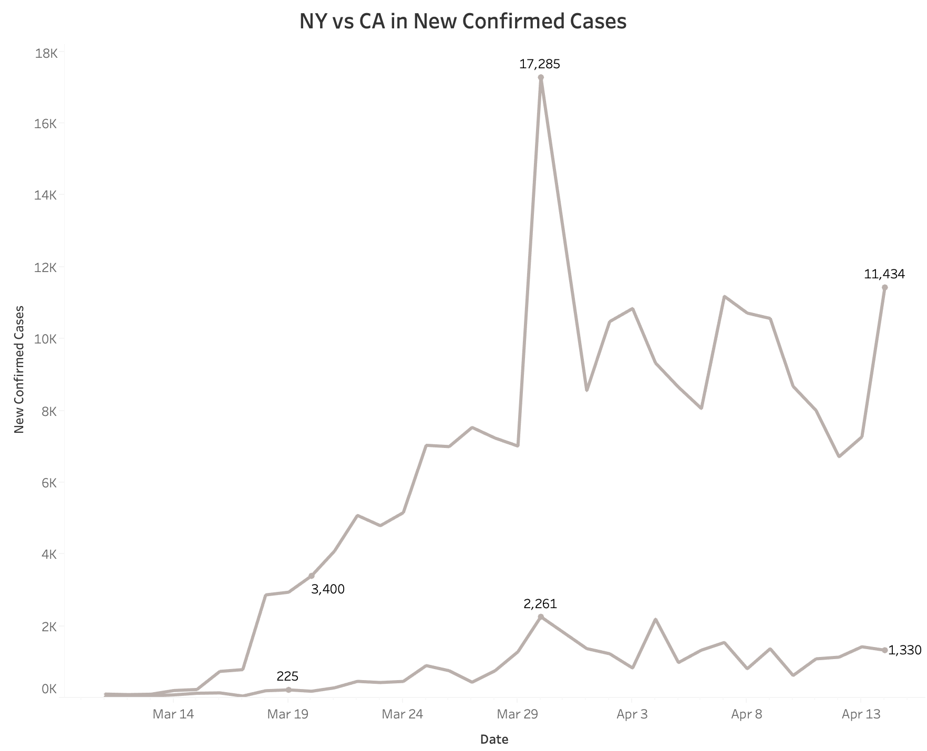
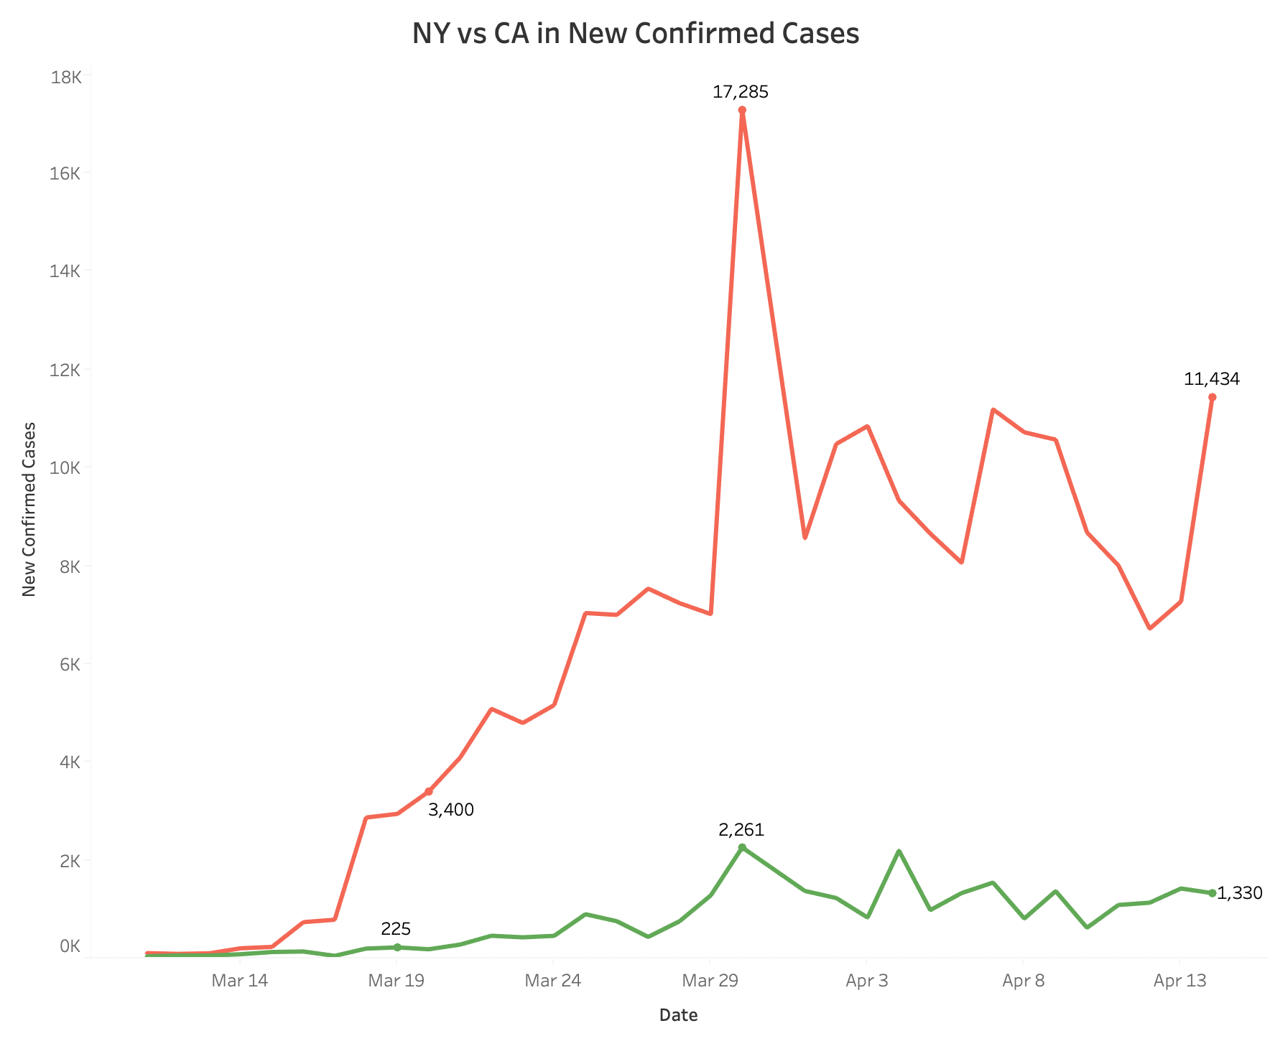


Comparison between CA and NY
Social Distancing Policies to control Pandemic
Gathering Size Limitation
Closure of Public Venues
Closure of Schools and Universities
Non-Essential Services Closure
Lock Down
Notes:
We first think of social distancing policy because it went so well in China. And both states released some social distancing policies to control the pandemic.
Based on our research, California implemented these methods much earlier than New York and the line is much flatter.
Thus, we assume social distancing policy might work, and it works the earlier the better.

Slide 6



Potential factors for COVID - 19
Ban gathering
Wearing masks
Number of airports
Education level
…...
Notes:
Are there any other potential factors that can also impact the spread of COVID-19? We also gathered several factors including education level and number of airports.

Slide 7
Framework and pipeline
Notes:
Then, let’s welcome Iris to talk about the framework of our project.

Slide 8



Questions
Multi-source data and information, how to integrate?
How to quantify the impact?
Which factor has the most influence?
Notes:
Thanks Mandy
So, we start with several questions:
1. There are so many data and information out there, how could we integrate them?
2. We know that some of these factors would probably affect the spread of COVID-19, but how to quantify it?
3. Among all those influential factors, which one has the largest impact?

Slide 9
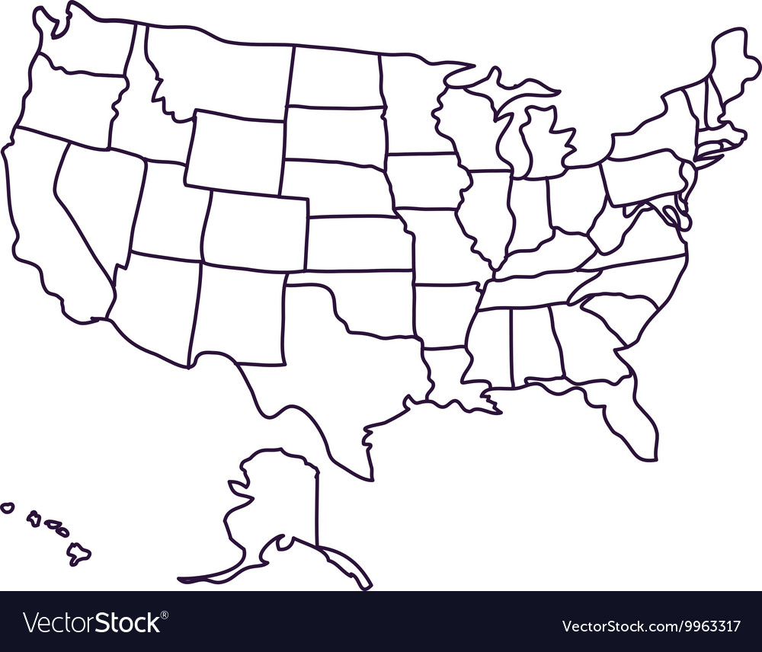






What relation are we investigating?
Factors
Social distancing
Demographics
link
Medicare
X
Y
Pandemic
Transportation
Education
Notes:
mTo answer these questions, we propose a framework that links factors to the pandemic.
We consider factors about social distancing policies, demographics, medical resources, transportation and education.
We want to somehow link all these factors to condition of the pandemic in US.

Slide 10
How does the whole project look like?
Data Collection
Data Processing
Model Fitting
Insights
Social Distancing (SD)
Medical Resources
Demographics
Geographic info
Combine multiple datasets
Assign strictness levels to SD policies
Calculate incremental ratio
Standardization
Correlation check
Feature selection
Linear Regression
Model score
Feature Statistical significance
Feature coefficient
Notes:
So, this is the project pipeline.
We first collect datasets from multiple sources.
Then, we process different datasets using different strategies. For example, since social distancing (SD) policy poses different limitations on gathering size, we assign each of them with a number representing its strictness.
After preparing the data, we perform linear regression with standardization and feature selection.
Finally, we gain insights from the model results and propose recommendations.

Slide 11
Data processing
Notes:
Now, let's welcome Yuting to further explain our approach.

Slide 12
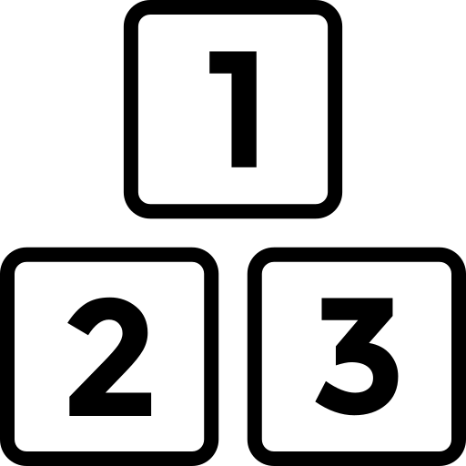
Where & How do we collect data?
Confirmed, death, recovered
Source: JHU dataset from GitHub
Social distancing
Source: COVID19 Panel Data from GitHub
Collection Method​
API​
Manual collection​
Demographic
Source: Wikipedia,
United States Census Bureau,
Medical
Source: https://data.cms.gov/ & https://data.medicare.gov/
Transportation
Source: GlobalAir.com
Education
Source: USA.com
Notes:
For this project, we gathered data from a wide range of sources to form a comprehensive perspective of the spread of COVID19.
We first extracted the number of confirmed, death, recovered cases from the JHU dataset.
Then, we got U.S. social distancing policy info from a COVID19 panel data on Github.
We also went to U.S Census Bureau, Wikipedia and government health sites to get demographic and health-related info.
In addition to these, we finally got data on transportation and education from aviation and local guide websites.
We collect data via API and manual collection.

Slide 13

X
Y
How to convert raw data to (X Y)?
Time-invariant State Info
Time-variant State Policy
Average Increment Ratio (AIR) (confirmed)
Time
Data
% >65 yrs. old
Policy 1
AIR 1
( X Y )
Medical resource index
Policy 2
AIR 2
( X Y )
# airports
Education Index
Policy ...
AIR ...
( X Y )
Notes:
Now let's take a deep dive into how we convert our raw data into X and Y values.
We first separate our X features into time-invariant info and time-variant information within different U.S. states.
Take the state of California for example, time-invariant data includes aging, medical resources, airport density and education index.
Then, we have the given state's state-wise social distancing policies as the time-variant feature.
Importantly, we segment the timeline according to the given state's policies.
In each segmented time interval, the social distancing policies (e.g., gathering bans, closure of public venues) remains the same.
Then, for each time interval, we compute the daily increment ratio of confirmed cases and take average, getting the average increment ratio, our Y variable.
Through this process, we get our model features about state info and policy configurations and our model target variable, the average increment ratio.

Slide 14
Data Frame
State | Social Distancing | Non-essential Business Closure | School Closure | Gathering Size Limitation | Closure of Public Venues | Policy Start Date | Aging | Education Index | ... | Average Increment Ratio
CA | 0 | 0 | 0 | 0 | 0 | 1/26/20 | 0.14 | 13.44 | ... | 0.13
CA | 1 | 0 | 0 | 1 | 0 | 3/5/2020 | 0.14 | 13.44 | ... | 0.24
CA | 1 | 0 | 0 | 3 | 0 | 3/11/2020 | 0.14 | 13.44 | ... | 0.26
... |  |  |  |  |  |  |  |  | ...
NY | 0 | 0 | 0 | 0 | 0 | 3/1/20 | 0.16 | 13.69 | ... | 0.89
NY | 0 | 0 | 0 | 2 | 0 | 3/12/20 | 0.16 | 13.69 | ... | 0.29
NY | 0 | 0 | 1 | 5 | 2 | 3/16/20 | 0.16 | 13.69 | ... | 0.68
Notes:
Now, let's take a look at what our final data frame looks like.
For each entry, we have state-wise social distancing policies, these policies' start date and other state information and the average increment ratio.

Slide 15
Data Frame
Social Distancing Policies
State | Social Distancing | Non-essential Business Closure | School Closure | Gathering Size Limitation | Closure of Public Venues | Policy Start Date | Aging | Education Index | ... | Average Increment Ratio
CA | 0 | 0 | 0 | 0 | 0 | 1/26/20 | 0.14 | 13.44 | ... | 0.13
CA | 1 | 0 | 0 | 1 | 0 | 3/5/2020 | 0.14 | 13.44 | ... | 0.24
CA | 1 | 0 | 0 | 3 | 0 | 3/11/2020 | 0.14 | 13.44 | ... | 0.26
... |  |  |  |  |  |  |  |  | ...
NY | 0 | 0 | 0 | 0 | 0 | 3/1/20 | 0.16 | 13.69 | ... | 0.89
NY | 0 | 0 | 0 | 2 | 0 | 3/12/20 | 0.16 | 13.69 | ... | 0.29
NY | 0 | 0 | 1 | 5 | 2 | 3/16/20 | 0.16 | 13.69 | ... | 0.68
Notes:
Now, let's take a look at what our final data frame looks like.
For each entry, we have state-wise social distancing policies, these policies' start date and other state information and the average increment ratio.

Slide 16
Data Frame
Social Distancing Policies
Policy Start Date
State | Social Distancing | Non-essential Business Closure | School Closure | Gathering Size Limitation | Closure of Public Venues | Policy Start Date | Aging | Education Index | ... | Average Increment Ratio
CA | 0 | 0 | 0 | 0 | 0 | 1/26/20 | 0.14 | 13.44 | ... | 0.13
CA | 1 | 0 | 0 | 1 | 0 | 3/5/2020 | 0.14 | 13.44 | ... | 0.24
CA | 1 | 0 | 0 | 3 | 0 | 3/11/2020 | 0.14 | 13.44 | ... | 0.26
... |  |  |  |  |  |  |  |  | ...
NY | 0 | 0 | 0 | 0 | 0 | 3/1/20 | 0.16 | 13.69 | ... | 0.89
NY | 0 | 0 | 0 | 2 | 0 | 3/12/20 | 0.16 | 13.69 | ... | 0.29
NY | 0 | 0 | 1 | 5 | 2 | 3/16/20 | 0.16 | 13.69 | ... | 0.68
Notes:
Now, let's take a look at what our final data frame looks like.
For each entry, we have state-wise social distancing policies, these policies' start date and other state information and the average increment ratio.

Slide 17
Data Frame
Other features
State | Social Distancing | Non-essential Business Closure | School Closure | Gathering Size Limitation | Closure of Public Venues | Policy Start Date | Aging | Education Index | ... | Average Increment Ratio
CA | 0 | 0 | 0 | 0 | 0 | 1/26/20 | 0.14 | 13.44 | ... | 0.13
CA | 1 | 0 | 0 | 1 | 0 | 3/5/2020 | 0.14 | 13.44 | ... | 0.24
CA | 1 | 0 | 0 | 3 | 0 | 3/11/2020 | 0.14 | 13.44 | ... | 0.26
... |  |  |  |  |  |  |  |  | ...
NY | 0 | 0 | 0 | 0 | 0 | 3/1/20 | 0.16 | 13.69 | ... | 0.89
NY | 0 | 0 | 0 | 2 | 0 | 3/12/20 | 0.16 | 13.69 | ... | 0.29
NY | 0 | 0 | 1 | 5 | 2 | 3/16/20 | 0.16 | 13.69 | ... | 0.68
Notes:
Now, let's take a look at what our final data frame looks like.
For each entry, we have state-wise social distancing policies, these policies' start date and other state information and the average increment ratio.

Slide 18
Data Frame
Target Variable
State | Social Distancing | Non-essential Business Closure | School Closure | Gathering Size Limitation | Closure of Public Venues | Policy Start Date | Aging | Education Index | ... | Average Increment Ratio
CA | 0 | 0 | 0 | 0 | 0 | 1/26/20 | 0.14 | 13.44 | ... | 0.13
CA | 1 | 0 | 0 | 1 | 0 | 3/5/2020 | 0.14 | 13.44 | ... | 0.24
CA | 1 | 0 | 0 | 3 | 0 | 3/11/2020 | 0.14 | 13.44 | ... | 0.26
... |  |  |  |  |  |  |  |  | ...
NY | 0 | 0 | 0 | 0 | 0 | 3/1/20 | 0.16 | 13.69 | ... | 0.89
NY | 0 | 0 | 0 | 2 | 0 | 3/12/20 | 0.16 | 13.69 | ... | 0.29
NY | 0 | 0 | 1 | 5 | 2 | 3/16/20 | 0.16 | 13.69 | ... | 0.68
Notes:
Now, let's take a look at what our final data frame looks like.
For each entry, we have state-wise social distancing policies, these policies' start date and other state information and the average increment ratio.

Slide 19
Data Frame
State | Social Distancing | Non-essential Business Closure | School Closure | Gathering Size Limitation | Closure of Public Venues | Policy Start Date | Aging | Education Index | ... | Average Increment Ratio
CA | 0 | 0 | 0 | 0 | 0 | 1/26/20 | 0.14 | 13.44 | ... | 0.13
CA | 1 | 0 | 0 | 1 | 0 | 3/5/2020 | 0.14 | 13.44 | ... | 0.24
CA | 1 | 0 | 0 | 3 | 0 | 3/11/2020 | 0.14 | 13.44 | ... | 0.26
... |  |  |  |  |  |  |  |  | ...
NY | 0 | 0 | 0 | 0 | 0 | 3/1/20 | 0.16 | 13.69 | ... | 0.89
NY | 0 | 0 | 0 | 2 | 0 | 3/12/20 | 0.16 | 13.69 | ... | 0.29
NY | 0 | 0 | 1 | 5 | 2 | 3/16/20 | 0.16 | 13.69 | ... | 0.68
Notes:
In our data frame, we include 14 states that have the social distancing data available. These states include NY, NJ, CA and WA where COVID-19 have the most impact.

Slide 20
Data Frame
State | Social Distancing | Non-essential Business Closure | School Closure | Gathering Size Limitation | Closure of Public Venues | Policy Start Date | Aging | Education Index | ... | Average Increment Ratio
CA | 0 | 0 | 0 | 0 | 0 | 1/26/20 | 0.14 | 13.44 | ... | 0.13
CA | 1 | 0 | 0 | 1 | 0 | 3/5/2020 | 0.14 | 13.44 | ... | 0.24
CA | 1 | 0 | 0 | 3 | 0 | 3/11/2020 | 0.14 | 13.44 | ... | 0.26
... |  |  |  |  |  |  |  |  | ...
NY | 0 | 0 | 0 | 0 | 0 | 3/1/20 | 0.16 | 13.69 | ... | 0.89
NY | 0 | 0 | 0 | 2 | 0 | 3/12/20 | 0.16 | 13.69 | ... | 0.29
NY | 0 | 0 | 1 | 5 | 2 | 3/16/20 | 0.16 | 13.69 | ... | 0.68
No Policy
Notes:
For each policy configuration, we record its start date.
California's data dates back to January

Slide 21
Data Frame
State | Social Distancing | Non-essential Business Closure | School Closure | Gathering Size Limitation | Closure of Public Venues | Policy Start Date | Aging | Education Index | ... | Average Increment Ratio
CA | 0 | 0 | 0 | 0 | 0 | 1/26/20 | 0.14 | 13.44 | ... | 0.13
CA | 1 | 0 | 0 | 1 | 0 | 3/5/2020 | 0.14 | 13.44 | ... | 0.24
CA | 1 | 0 | 0 | 3 | 0 | 3/11/2020 | 0.14 | 13.44 | ... | 0.26
... |  |  |  |  |  |  |  |  | ...
NY | 0 | 0 | 0 | 0 | 0 | 3/1/20 | 0.16 | 13.69 | ... | 0.89
NY | 0 | 0 | 0 | 2 | 0 | 3/12/20 | 0.16 | 13.69 | ... | 0.29
NY | 0 | 0 | 1 | 5 | 2 | 3/16/20 | 0.16 | 13.69 | ... | 0.68
No Policy
First Policy Out
Notes:
and has its first social distancing policy rolled out on March 5.

Slide 22
Data Frame
Multi-level Policy Strictness
State | Social Distancing | Non-essential Business Closure | School Closure | Gathering Size Limitation | Closure of Public Venues | Policy Start Date | Aging | Education Index | ... | Average Increment Ratio
CA | 0 | 0 | 0 | 0 | 0 | 1/26/20 | 0.14 | 13.44 | ... | 0.13
CA | 1 | 0 | 0 | 1 | 0 | 3/5/2020 | 0.14 | 13.44 | ... | 0.24
CA | 1 | 0 | 0 | 3 | 0 | 3/11/2020 | 0.14 | 13.44 | ... | 0.26
... |  |  |  |  |  |  |  |  | ...
NY | 0 | 0 | 0 | 0 | 0 | 3/1/20 | 0.16 | 13.69 | ... | 0.89
NY | 0 | 0 | 0 | 2 | 0 | 3/12/20 | 0.16 | 13.69 | ... | 0.29
NY | 0 | 0 | 1 | 5 | 2 | 3/16/20 | 0.16 | 13.69 | ... | 0.68
Notes:
Take a look at the gathering size limitation, note that it has multiple levels. This is due to the fact that gathering bans are rolled out with stricter gathering size limit.

Slide 23
Data Frame
State | Social Distancing | Non-essential Business Closure | School Closure | Gathering Size Limitation | Closure of Public Venues | Policy Start Date | Aging | Education Index | ... | Average Increment Ratio
CA | 0 | 0 | 0 | 0 | 0 | 1/26/20 | 0.14 | 13.44 | ... | 0.13
CA | 1 | 0 | 0 | 1 | 0 | 3/5/2020 | 0.14 | 13.44 | ... | 0.24
CA | 1 | 0 | 0 | 3 | 0 | 3/11/2020 | 0.14 | 13.44 | ... | 0.26
... |  |  |  |  |  |  |  |  | ...
NY | 0 | 0 | 0 | 0 | 0 | 3/1/20 | 0.16 | 13.69 | ... | 0.89
NY | 0 | 0 | 0 | 2 | 0 | 3/12/20 | 0.16 | 13.69 | ... | 0.29
NY | 0 | 0 | 1 | 5 | 2 | 3/16/20 | 0.16 | 13.69 | ... | 0.68
Same-policy Interval
Notes:
Finally, we have the average increment ratio, which is calculated using data spanning from the policy start date in the same row until that in the next row, which is the end of the current policy.

Slide 24
Modeling and Insights

Slide 25
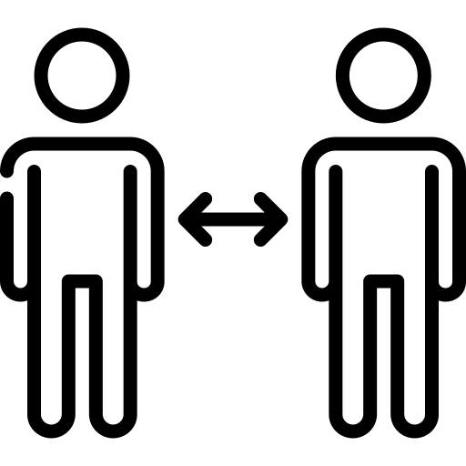


Modeling
Independent Variables
Social distancing Policy Index
Dependent Variable
Population Density
Linear Regression
Incremental Ratio
Airport Density
Education Index
Notes:
Yuting has introduced how we process our data, to recap, We have used these features to build a linear regression model to predict Incremental rate.

Slide 26
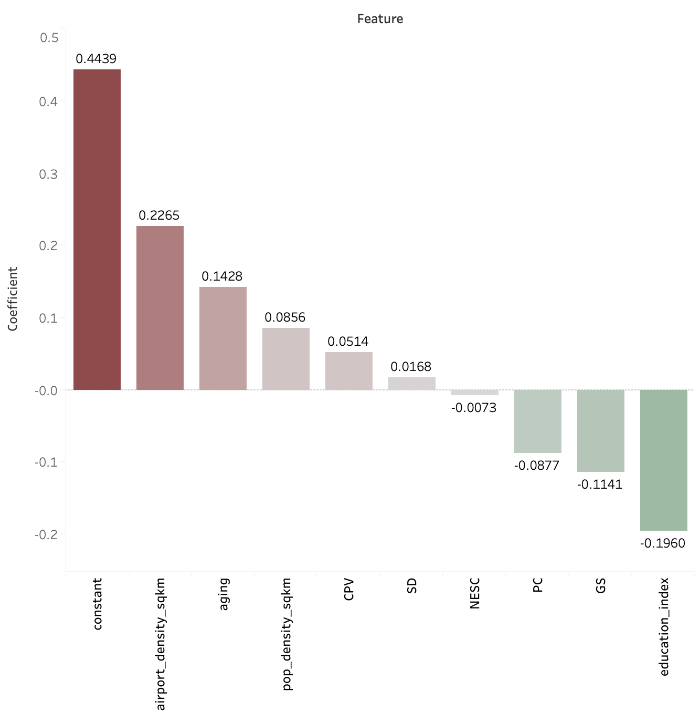
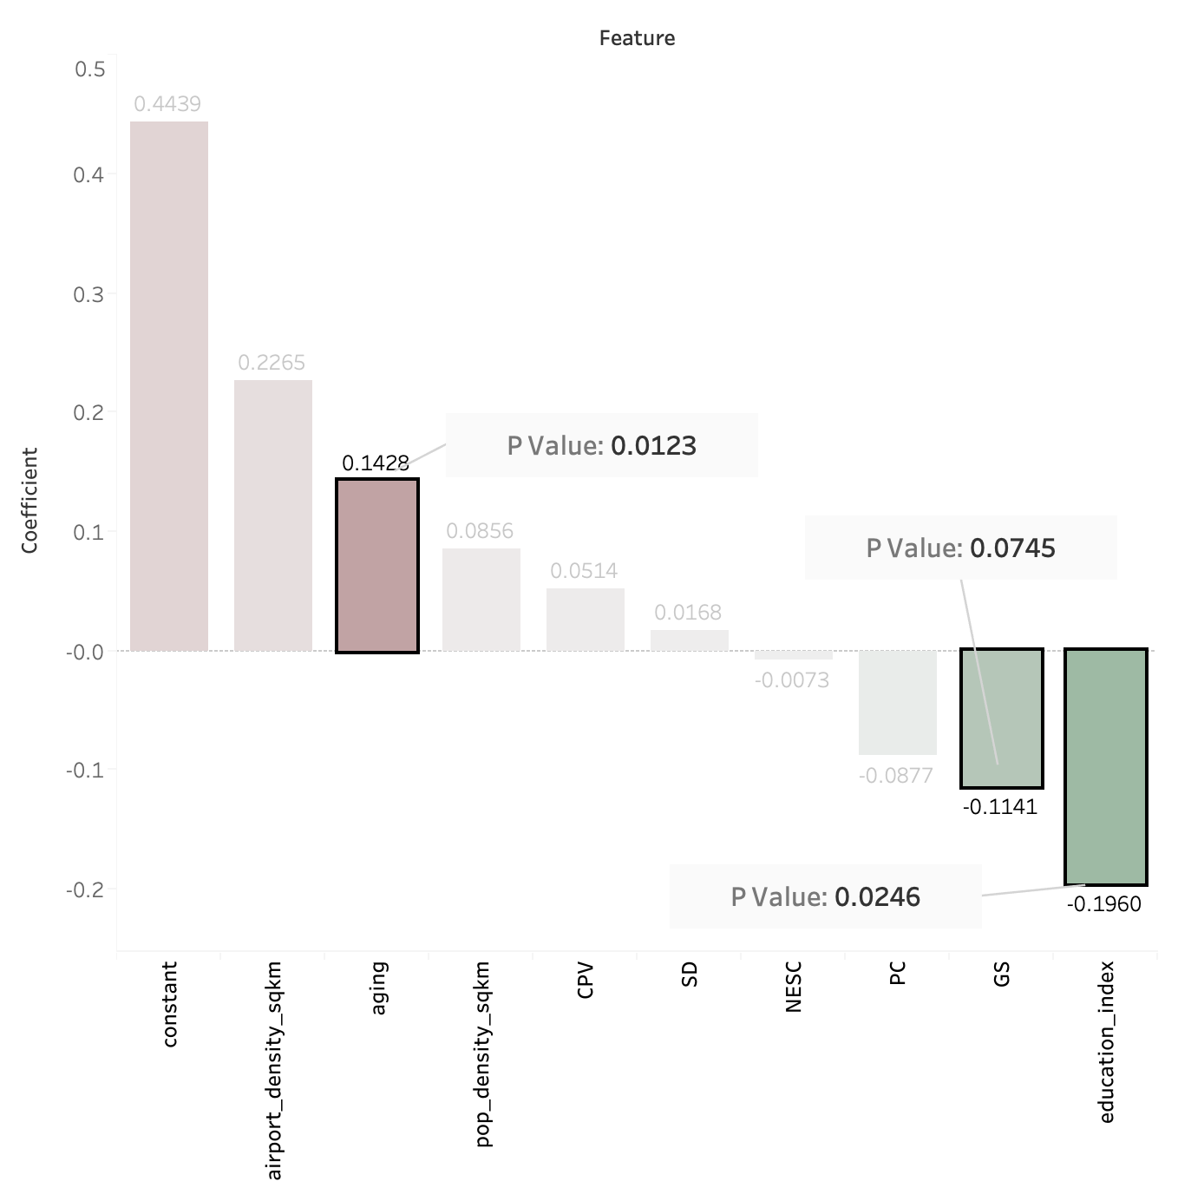





Insights from Modeling
Significant variables
Aging Index
Gathering size lim
Education Index
Notes:
Here's our findings from the outcome of our model.
The graph here shows the coefficients for the variables we used. The red columns are those with positive coefficients,meaning that higher the value higher the incremental rate and the green columns are those with negative coefficients.
We highlight three variables that are statistically significant, which are aging, gathering size limitations (GS) and education index.
Aging makes sense because as some research suggests that elder people may be easier to get infected. Also, as everyone knows that social distancing can prevent the spread of COVID-19. We have found from the model that among all the social distancing policies, limitations on group size has the greatest impact.
Another surprising finding is that education index has lots of impact on the infection rate. Especially when we only look at the absolute value for coefficients, it's highest among the three features.
(找出education index高的州和SD高低的州)

Slide 27

Insights and Value
Recommendations
Project Value
Education index More attention
Replicable framework
Aging Index More resources
Data collection and analytics pipeline
Gathering Size Stricter policy
Notes:
There are two major values from our project.
The first one is our recommendations based on our analysis. For the countries where this virus is not very serious currently, the government should spend more resource to 宣传 in area with lower education level. And it's very important for government to limit the size for group gathering even in very early state.
Another value from our project is our Replicable framework and data collection pipeline.
Currently we are conductin analysis on the US states, but this analysis approach can be used for other countries or scale to a worldwide level.
Also, we have built this dataset with external information about US states and with an automated pipeline to aggregate the lates state level COVID-19 data.

Slide 28
THANK YOU

Slide 29
Appendix 2 - Data Dictionary
Social Distancing
SD | Social Distancing of the general population
LD | Lock Down
NESC | Non-Essential Services Closure
PC | Closure of schools and universities
CPV | Closure of Public Venues
GS | Gathering size limitation
Demographic
pop_density_sqkm | Population Density (people / sqkm)
aging | Proportion of 65+ population
Medicare
surgical_quality | Surgical medical level
medicare disparity | Average Principle Cost
Transportation
airport_density_sqkm | number of airports/area of state(sqkm)
Education
education_index | average education level of the population

